Slide 1
Tryit.com is a concept that matches providers of unique experiences with those who are interested in trying something new.
Users search by zip code to find experiences that are available in their area and book them online.
These experiences are mini-workshops that are private. They are perfect for someone who is not ready to commit to a formal class or who is just, genuinely, curious about a topic. I do not own the rights to this concept, name or URL. For educational use only.

Slide 2
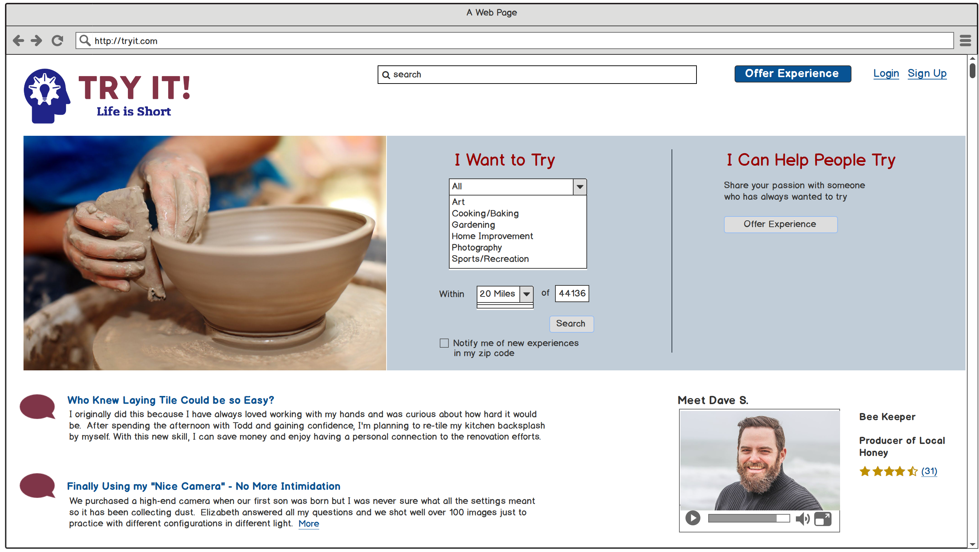
Home Page > User is not signed in and is not required to be just to browse. Drop down is open just to illustrate idea

Slide 3
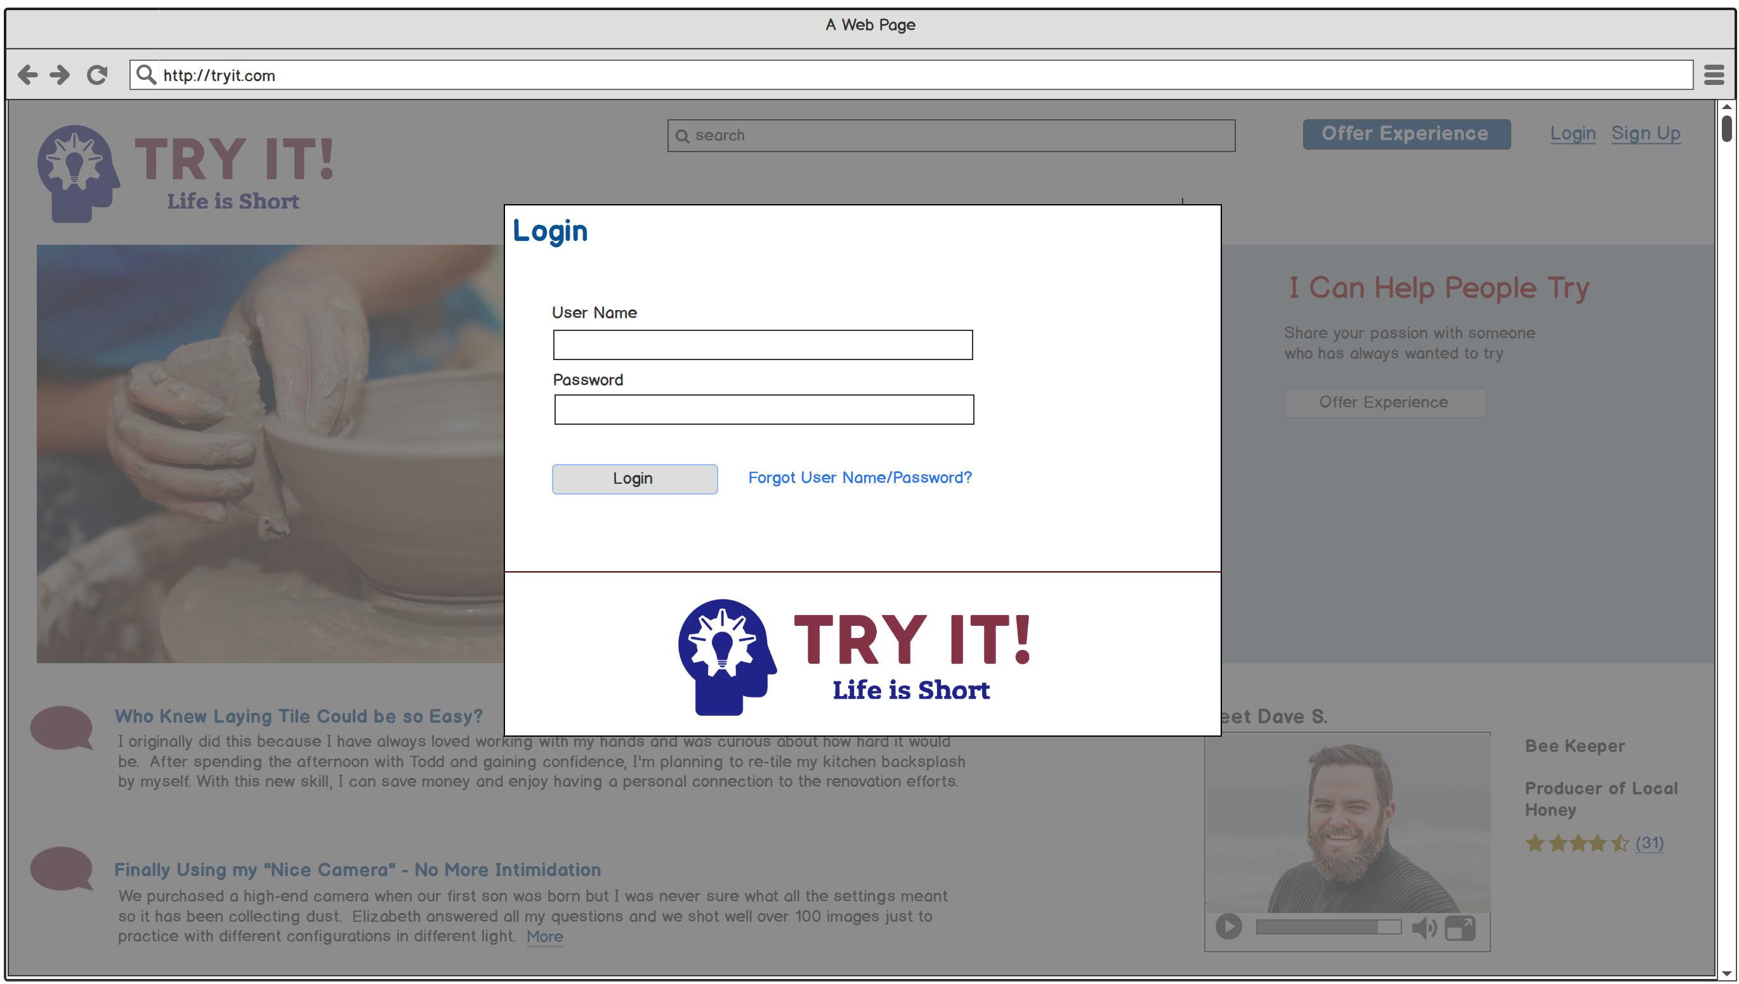
Home Page > Returning user decides to sign in

Slide 4
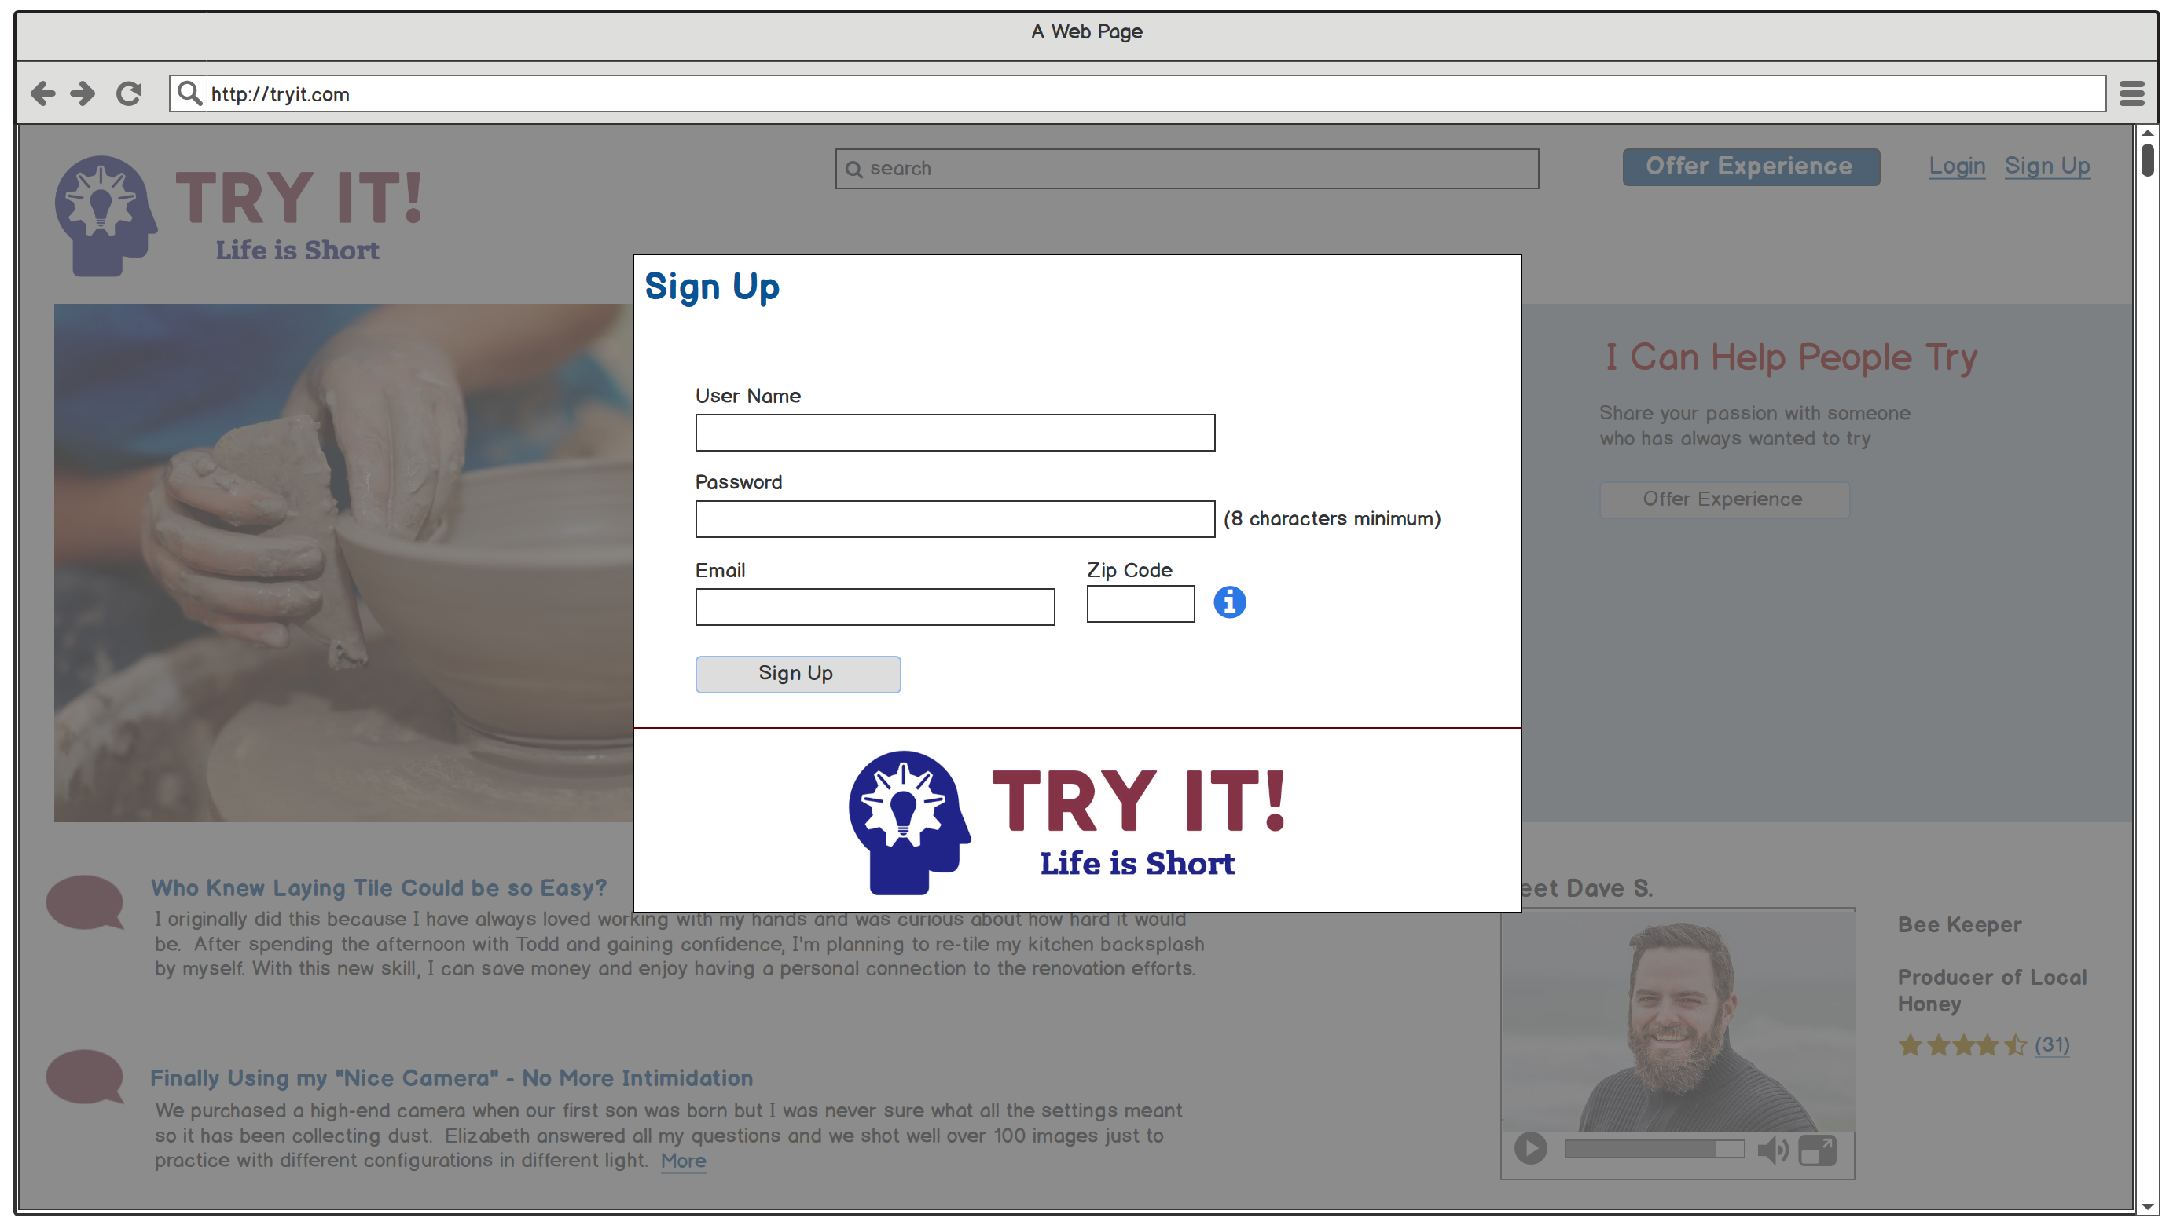
Home Page > New user, Megan Shaw, decides to create an account

Slide 5
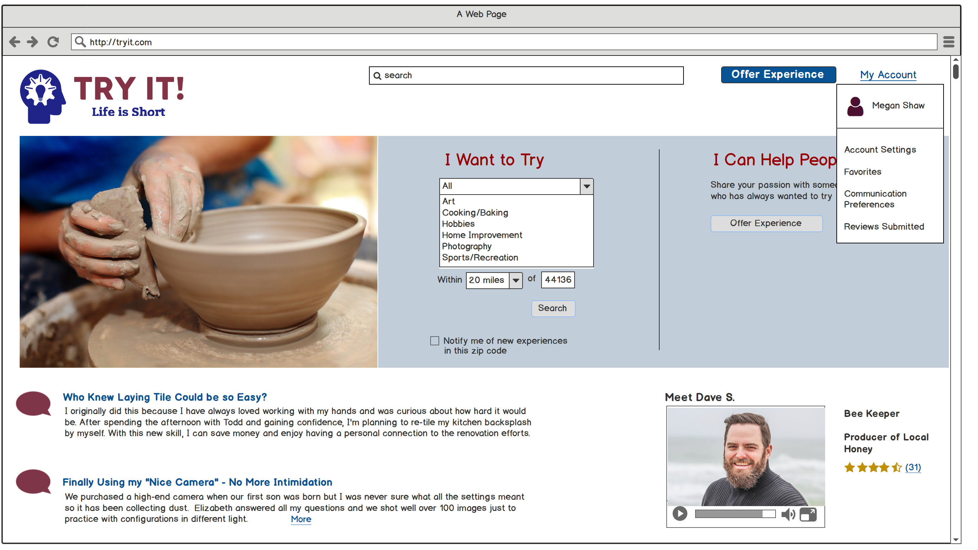
Home Page > Megan Shaw reviews her new account settings

Slide 6
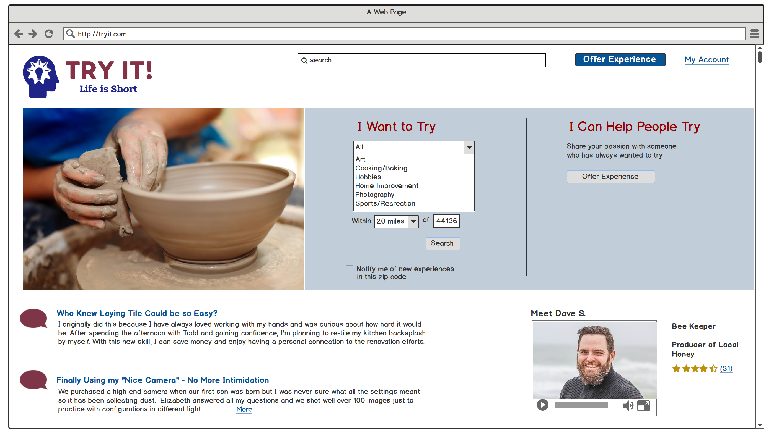
Home Page > Megan searches for “all experiences” near her zip code

Slide 7
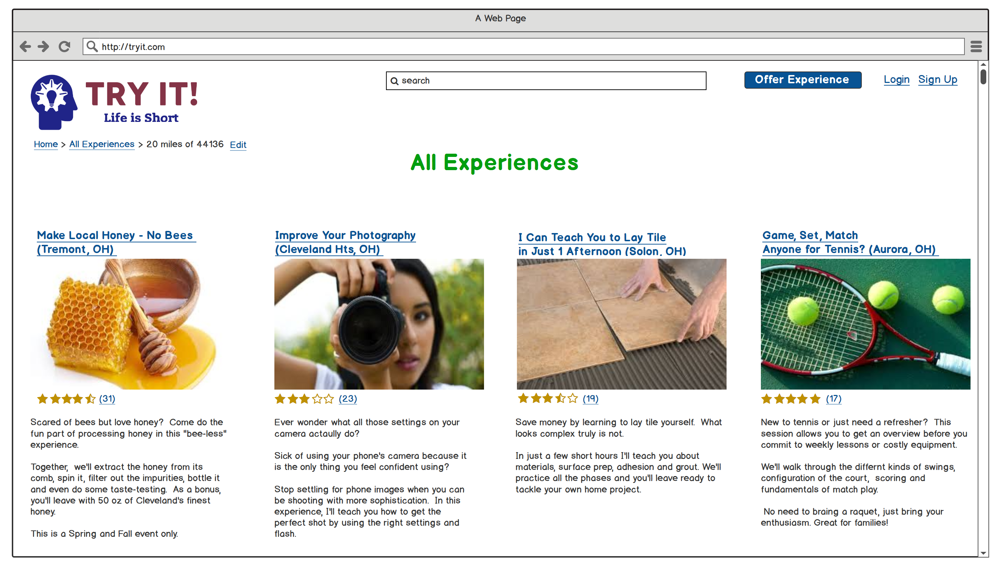
Results page for All Experiences > Megan clicks on the “local honey” experience

Slide 8
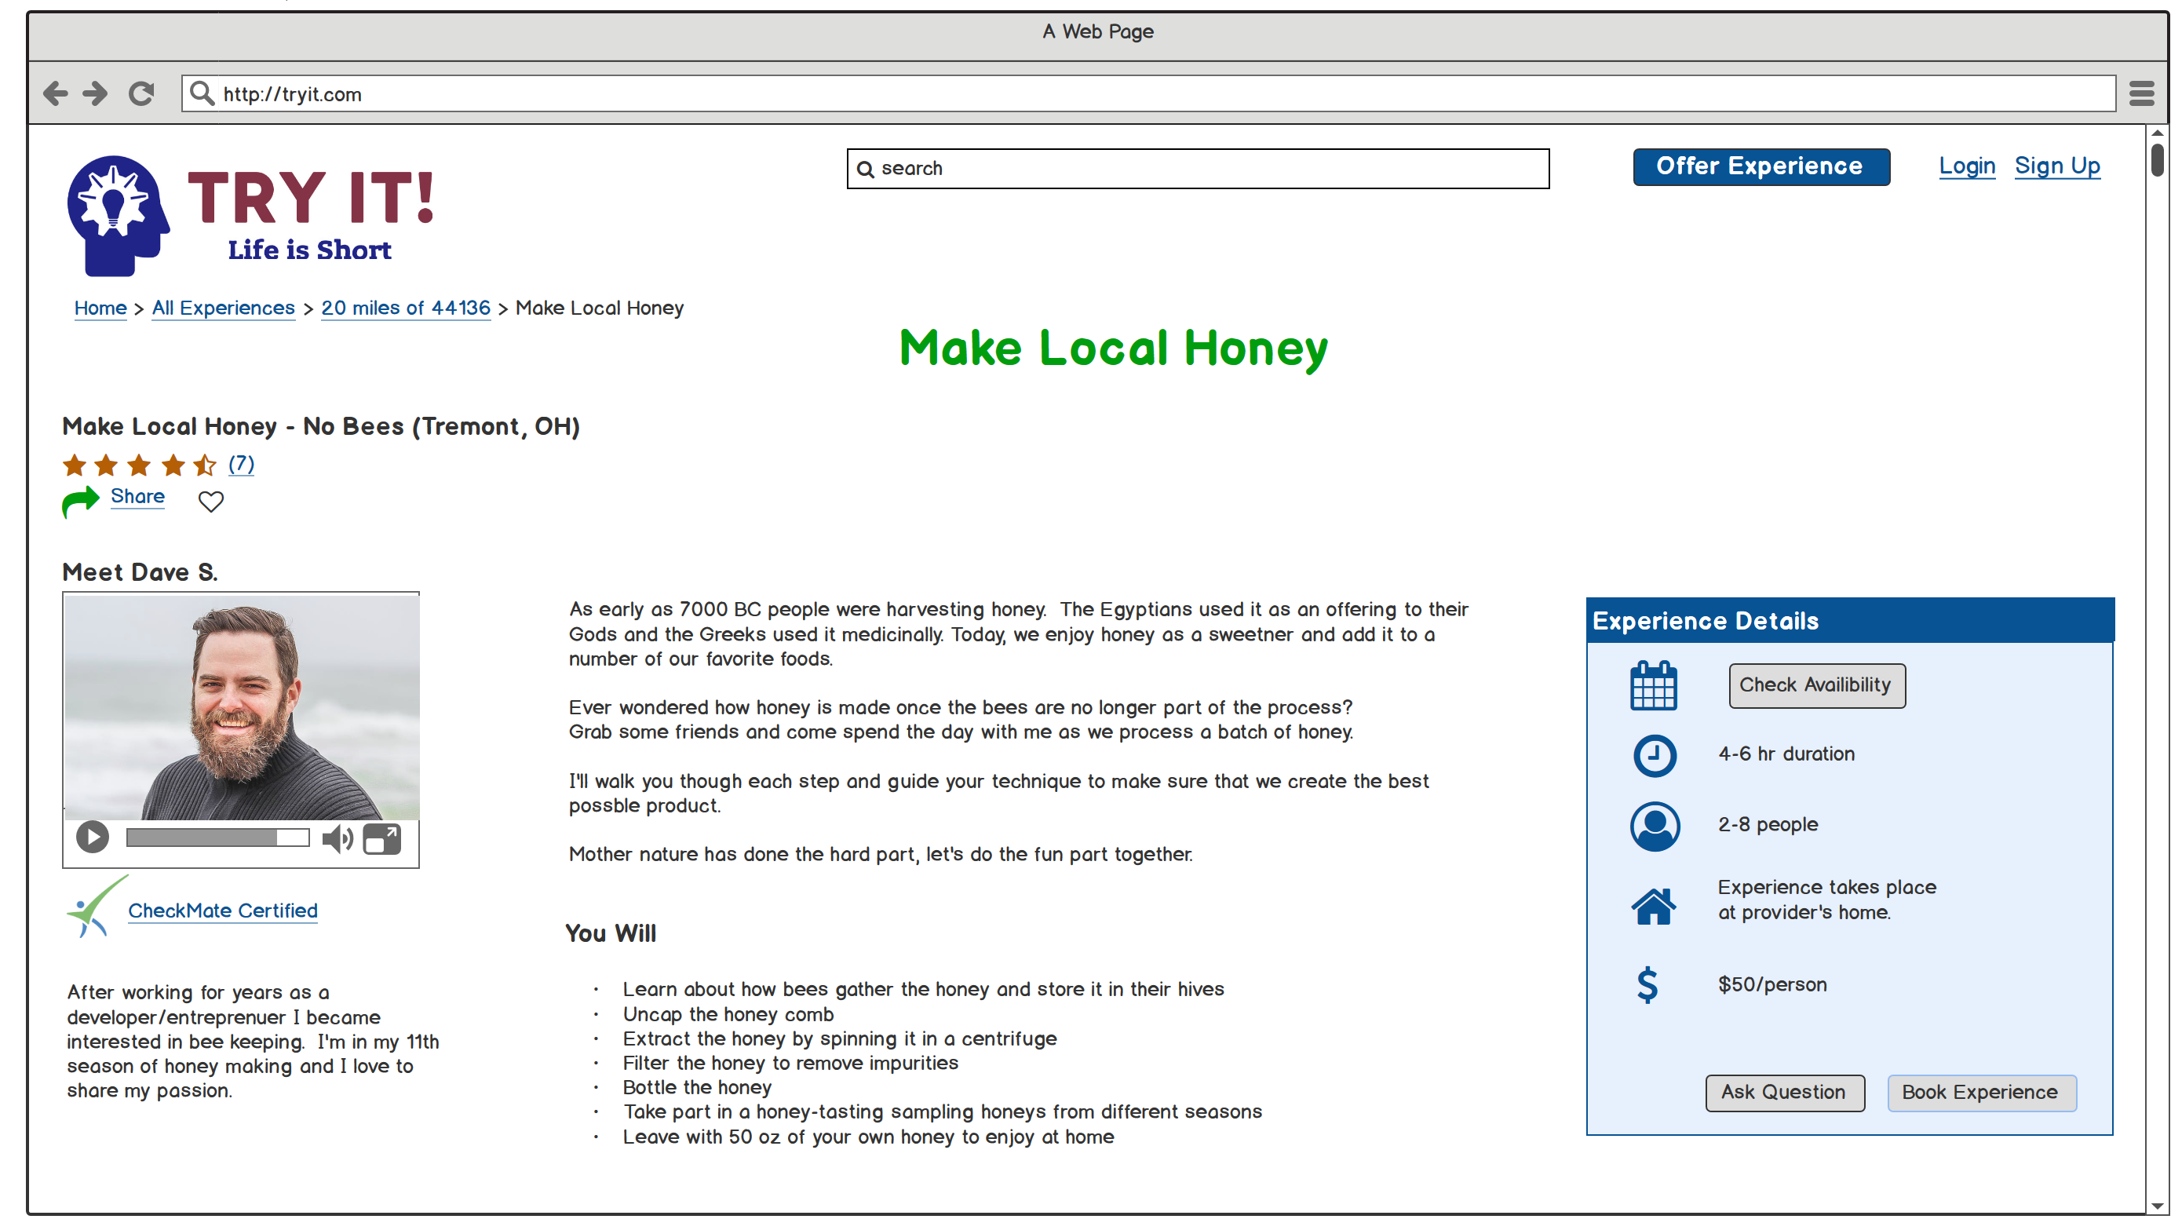
Detail Page for Make Local Honey Experience > Megan decides to book the experience

Slide 9
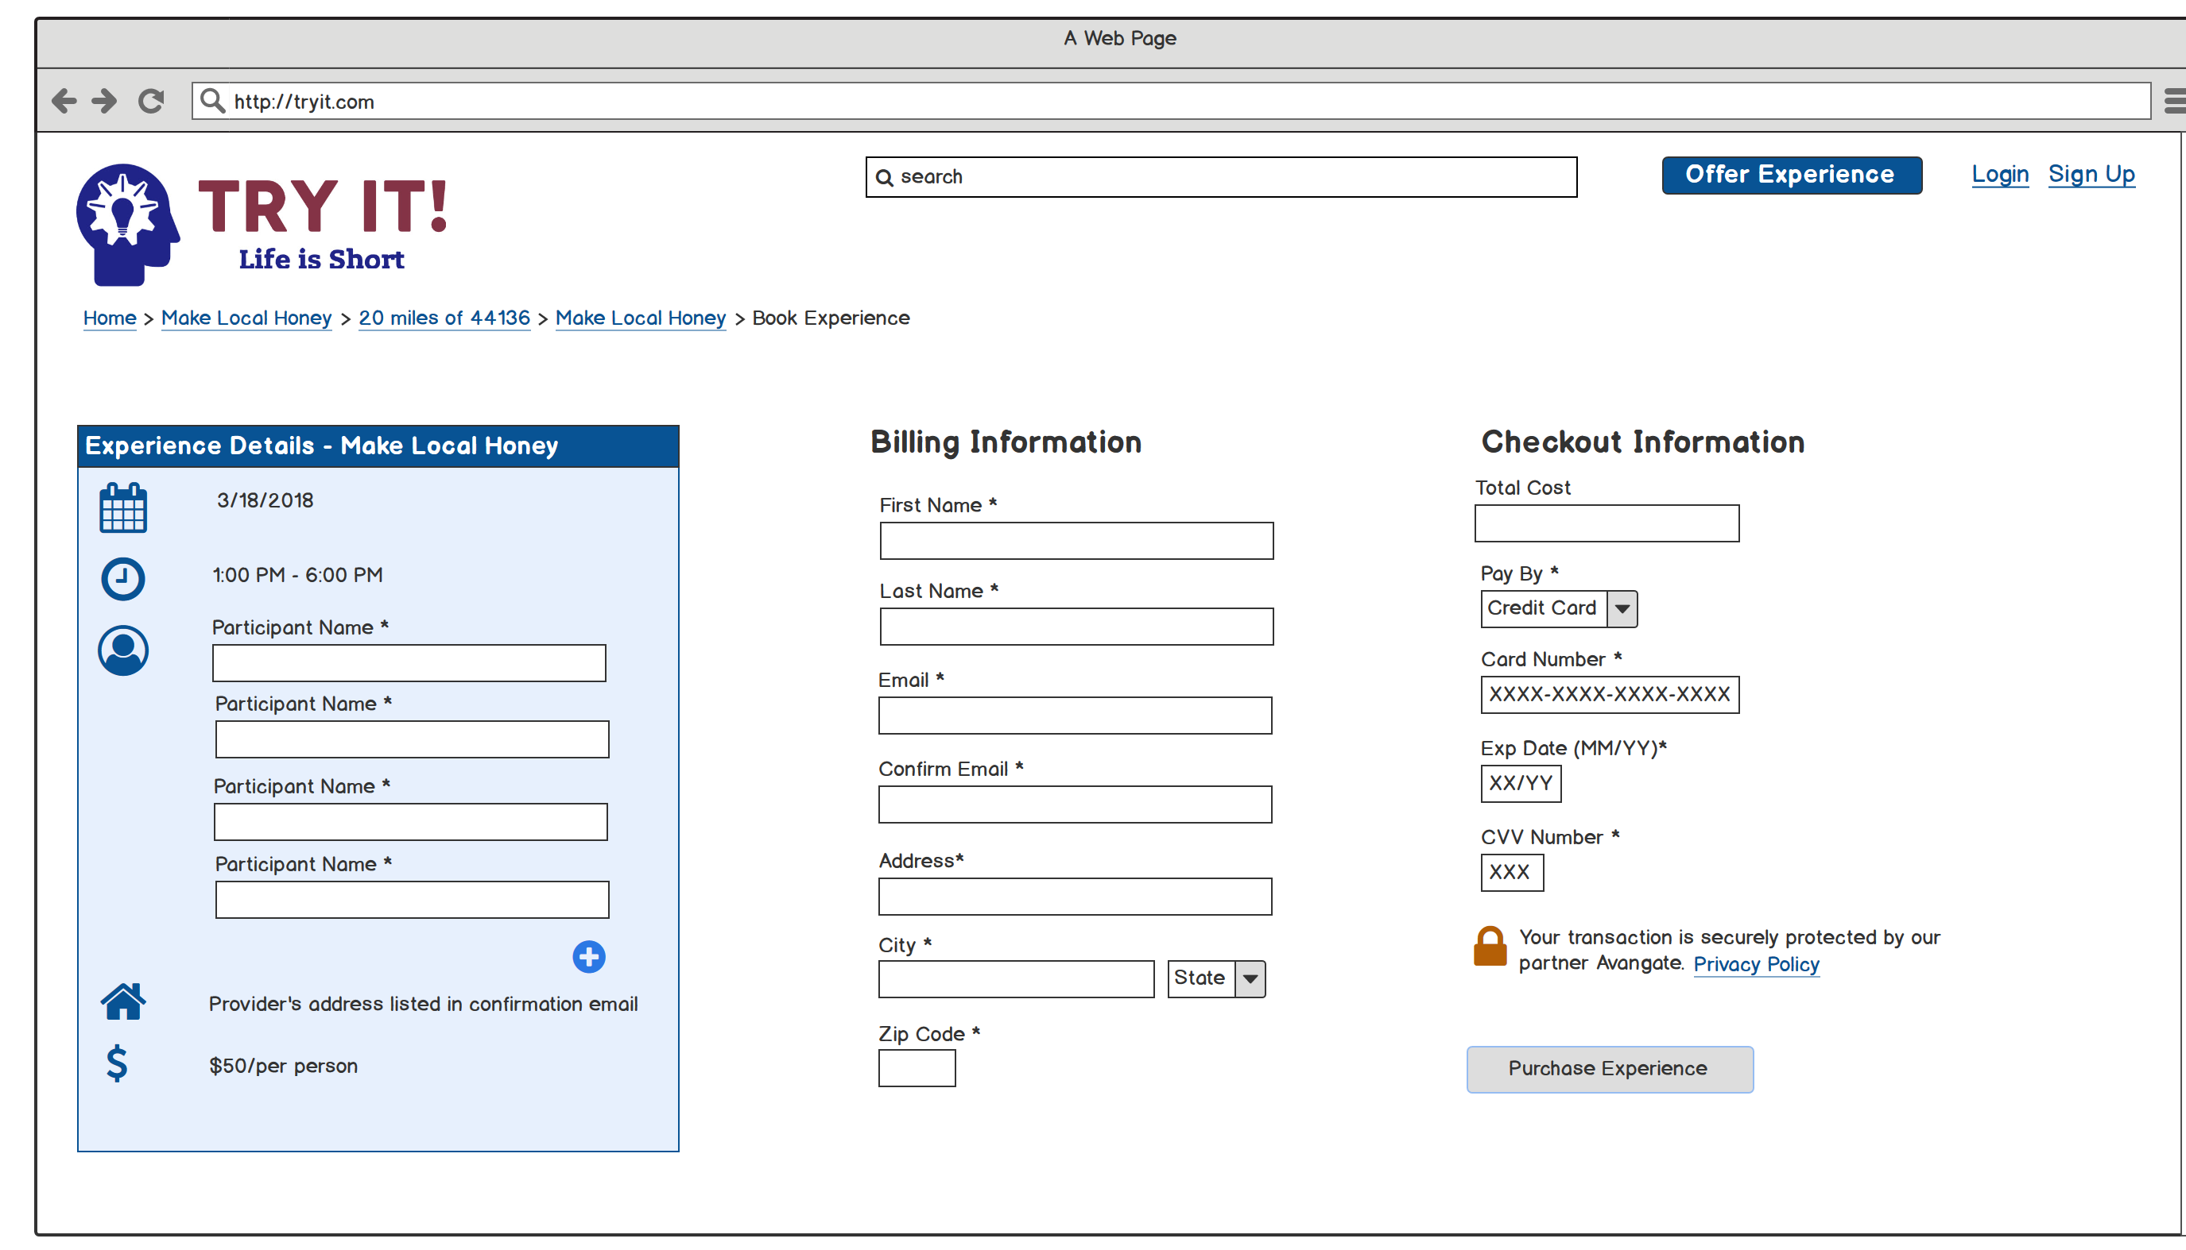
Book Experience > Megan completes all the fields and will receive a confirmation email shortly.

Slide 10
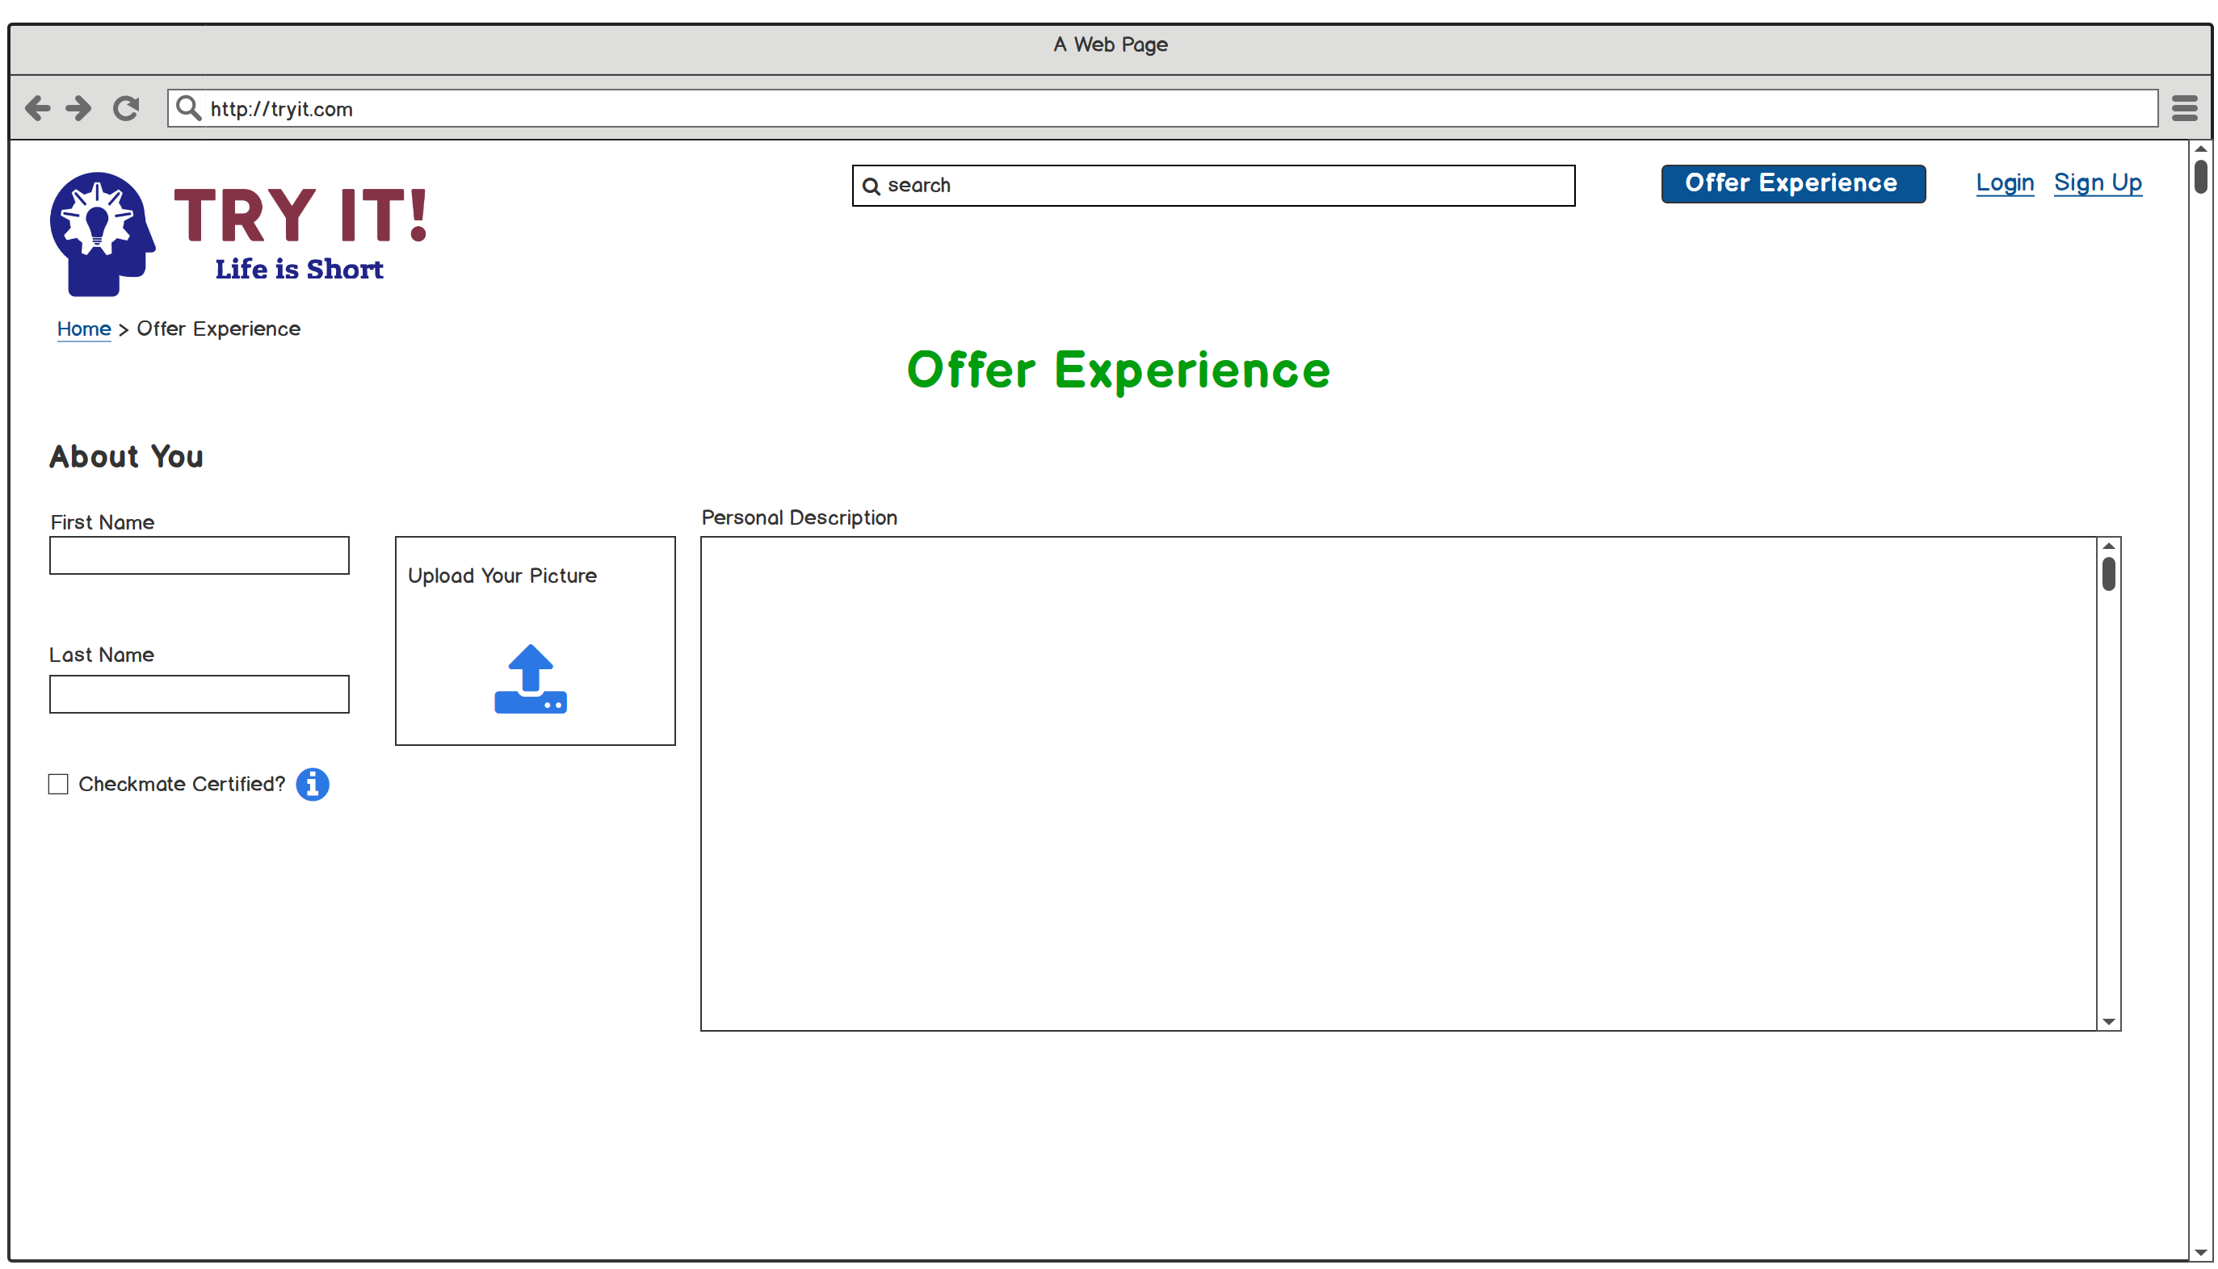
Page scrolls
Offer Experience (1/2) > Several months later, Megan returns to the site and decides to become an “experience provider”

Slide 11
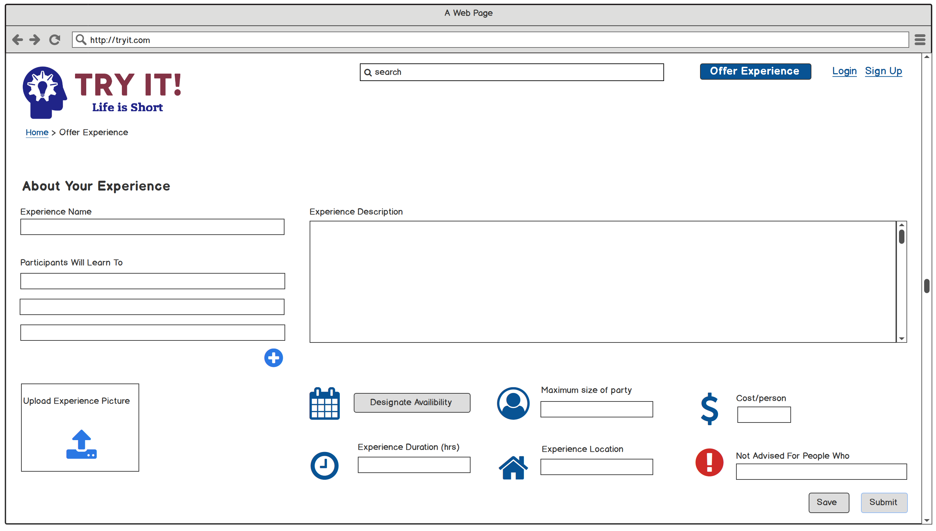
Offer Experience (2/2) > Megan submits her experience to Tryit.com

Slide 12
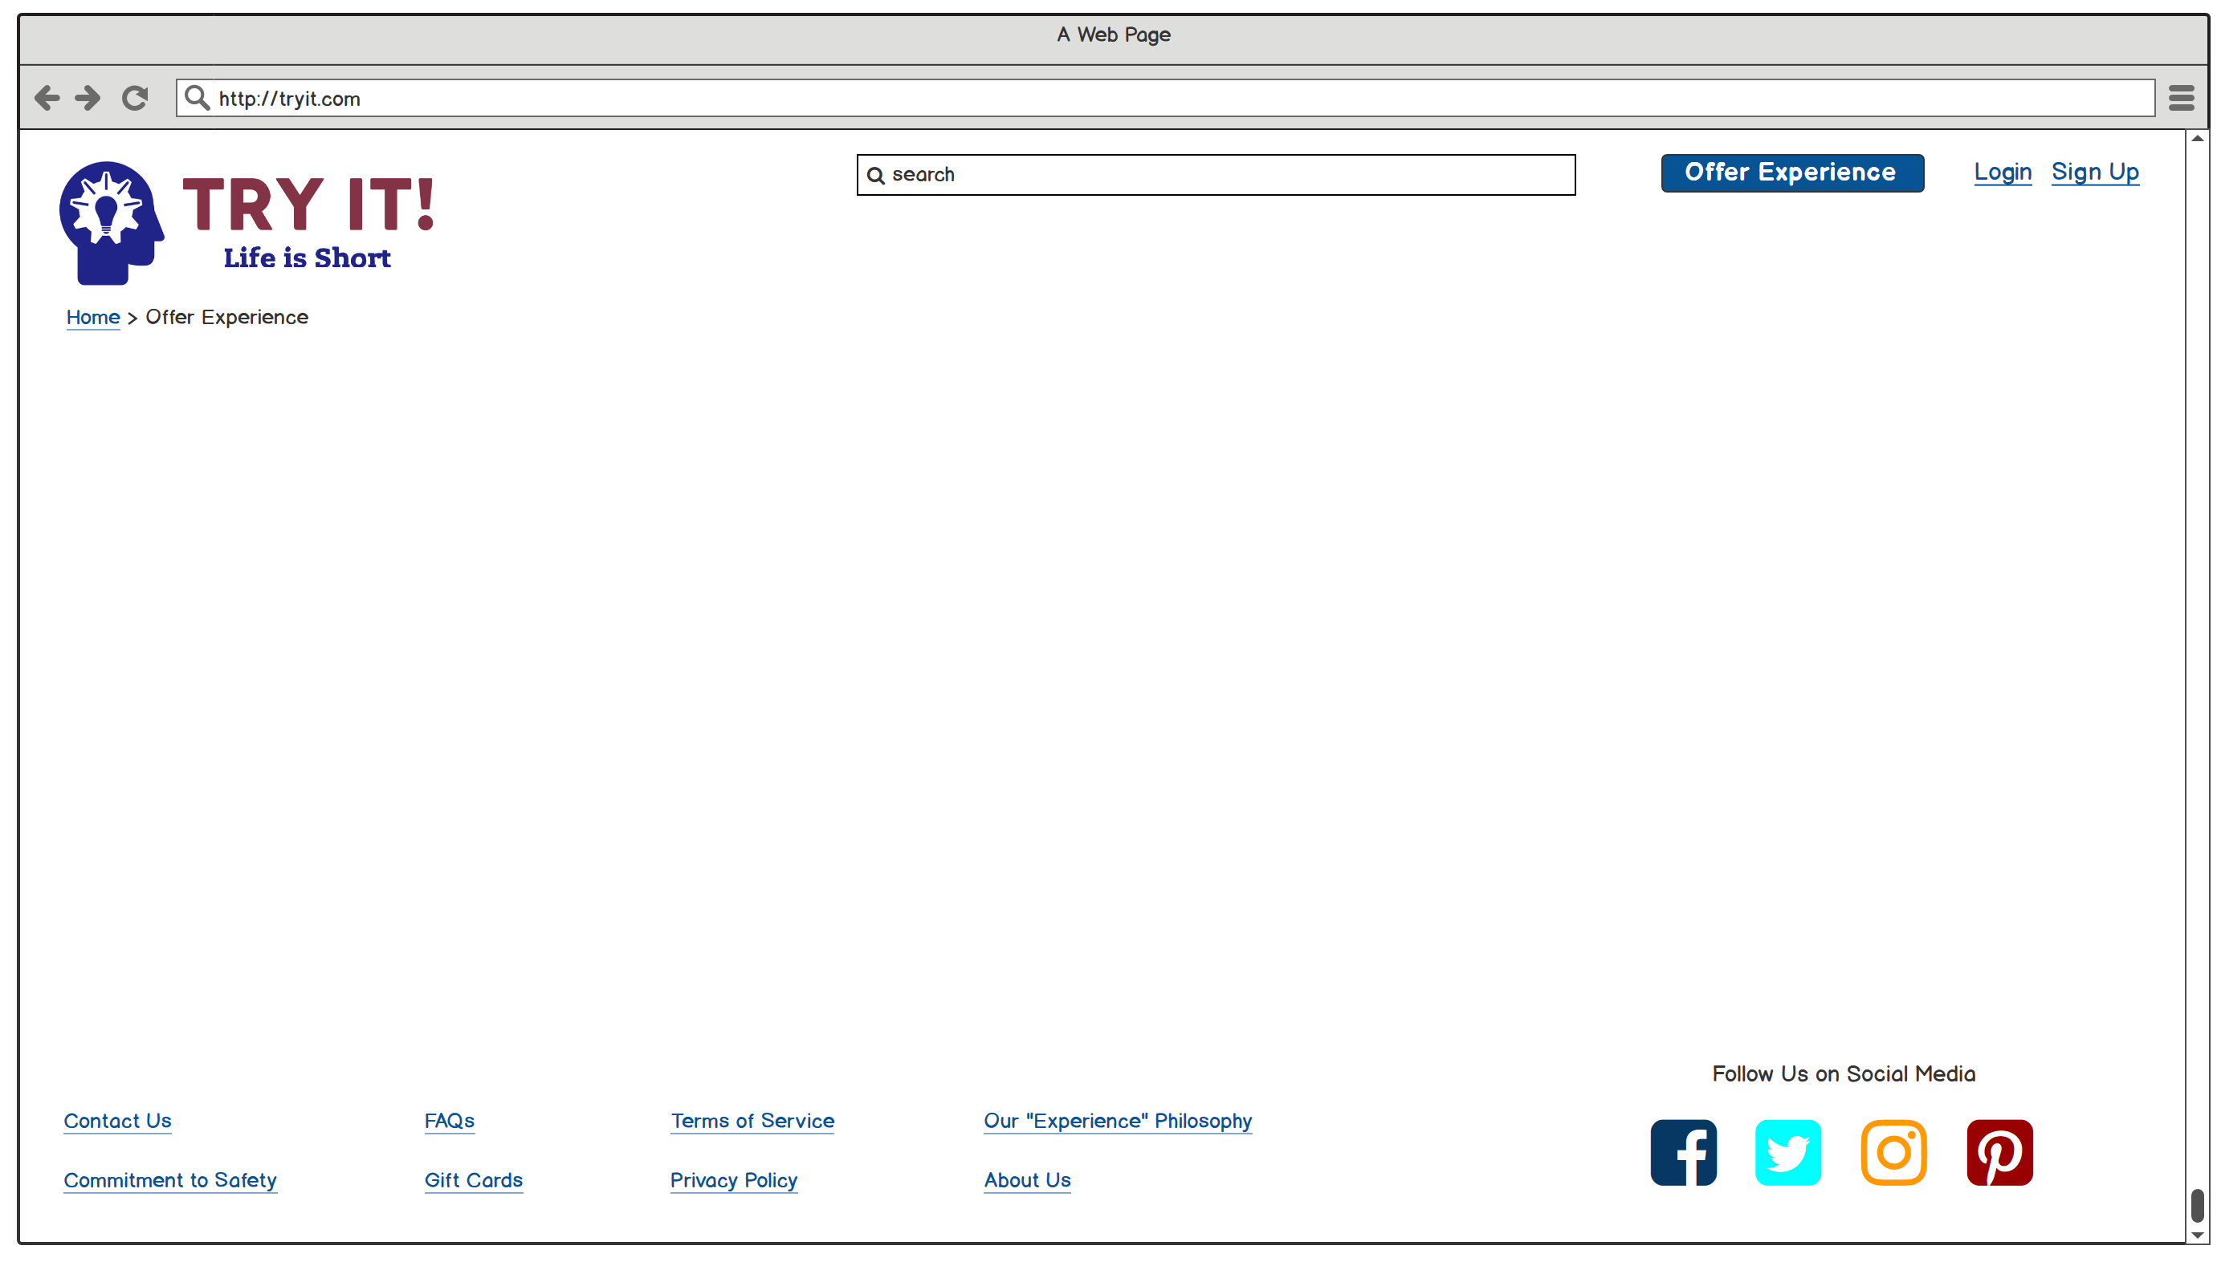
Sample footer (not visible on previous screens)

